Slide 1


AI Needs & Opportunities in the Startup Ecosystem
Insights from the AI Showcase Virtual Conference
Prepared by Data Frank

Slide 2

Project Overview
Analyzed needs and trends among AI startup stakeholders:
Founders, Startups, Investors, Freelancers, Companies
Data sourced from a virtual AI showcase
Aimed to uncover AI service demand, tool usage, and regional trends
Strategic recommendations for investors, accelerators, and AI providers
Data Frank
Data Frank

Slide 3

Project Objective
What Does the AI Ecosystem Need Right Now?
Focus Areas:
Founders’ interest in services, training, and automation
Investors’ focus by stage and region
Startups’ fundraising stage and location
Freelancers’ AI tool usage and service alignment
Data Frank

Slide 4
Data Source & Structure
Key Sheets:
Full list of attendees
AI freelancers & agencies
AI investors
AI startups
Companies seeking AI automation
Structure Includes:
Name, Email, Company, Tools used
Funding stage, Regions of interest
AI services needed (binary flags or text)
Data Frank
Data Frank

Slide 5
Data Source & Structure
About the Dataset
Key Sheets:
Structure Includes:
Full list of attendees
AI freelancers & agencies
AI investors
AI startups
Companies seeking AI automation
Name, Email, Company, Tools used
Funding stage, Regions of interest
AI services needed (binary flags or text)
Data Frank

Slide 6
Cleaning & Preparation
Actions Taken:
Renamed and simplified column headers
Converted responses to binary (0/1)
Cleaned text inputs (regex for tool separation)
Removed irrelevant entries like “n/a” or “none”
Reshaped wide → long format for regional analysis
Data Frank
Data Frank

Slide 7
Key Questions Answered
What We Investigated:
What AI needs do founders have?
What funding stages do investors prefer?
What tools do freelancers use most?
Where are investors focused geographically?
How do startup stages align with region?
Who is seeking training or automation?
Data Frank
Data Frank

Slide 8

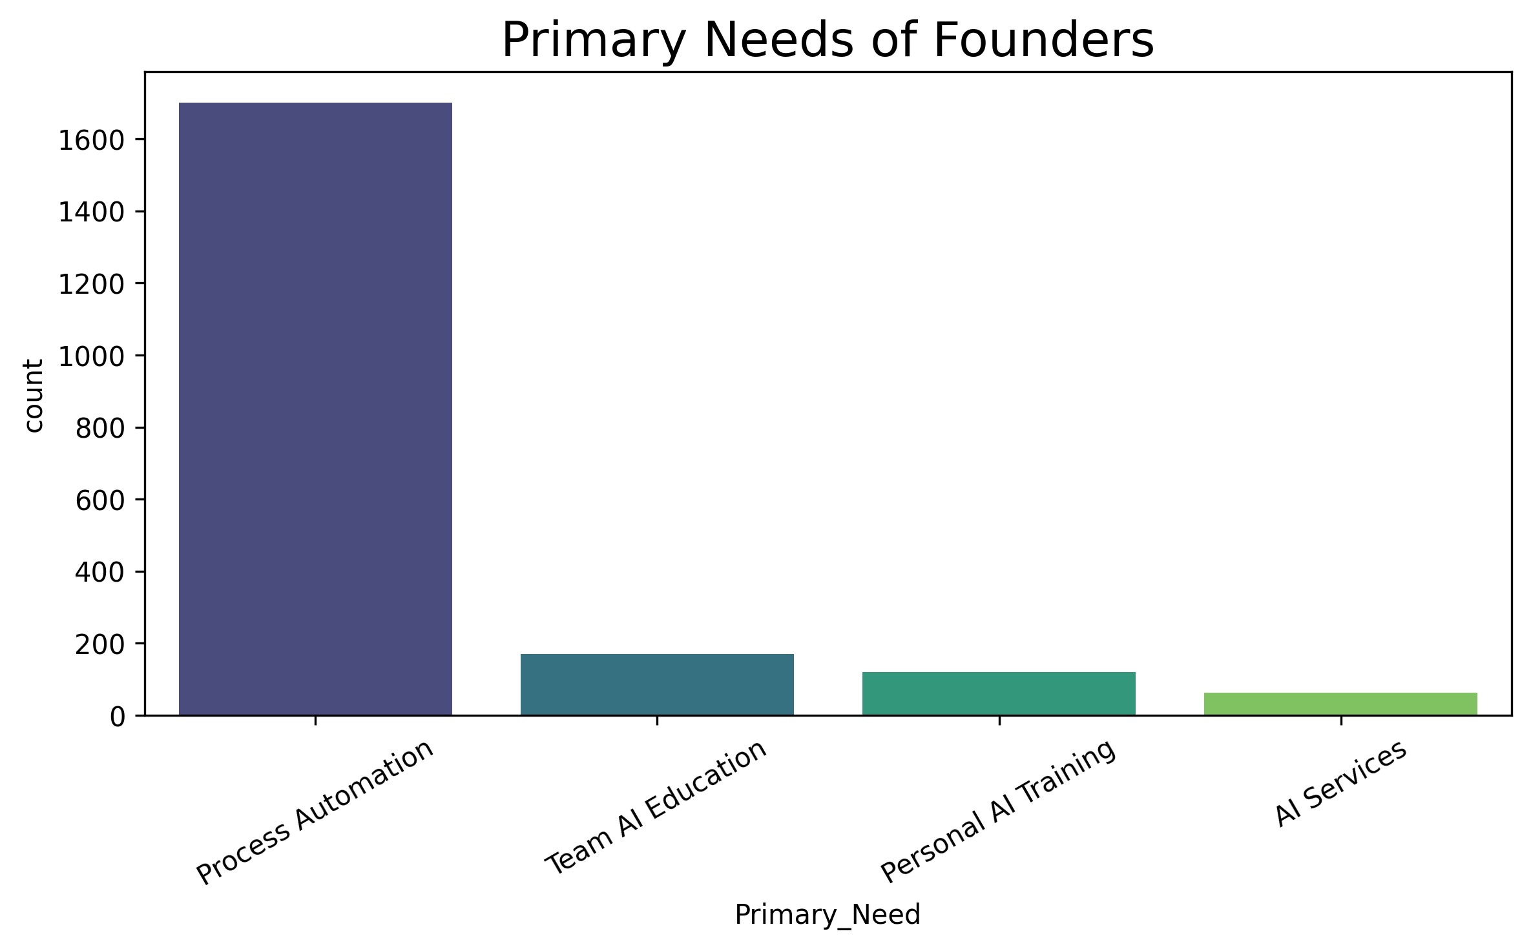
1. What AI needs do founders have?
Key Takeaways:
Process Automation is the top priority
Other common needs includes: Ai Services, Personal AI Training and Team Education
Data Frank

Slide 9
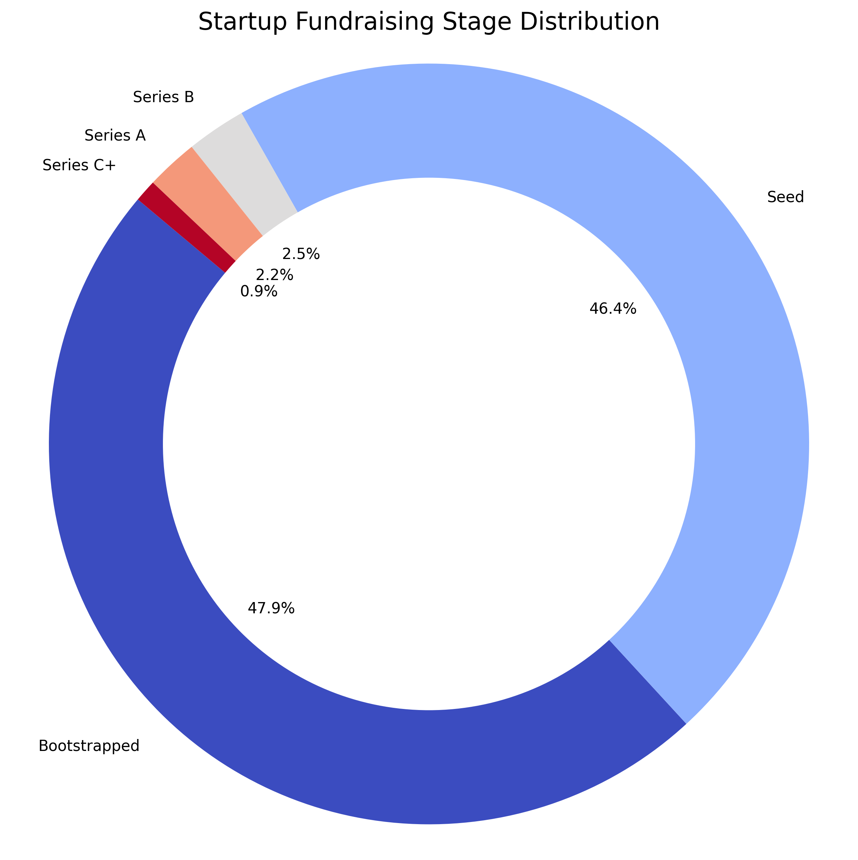
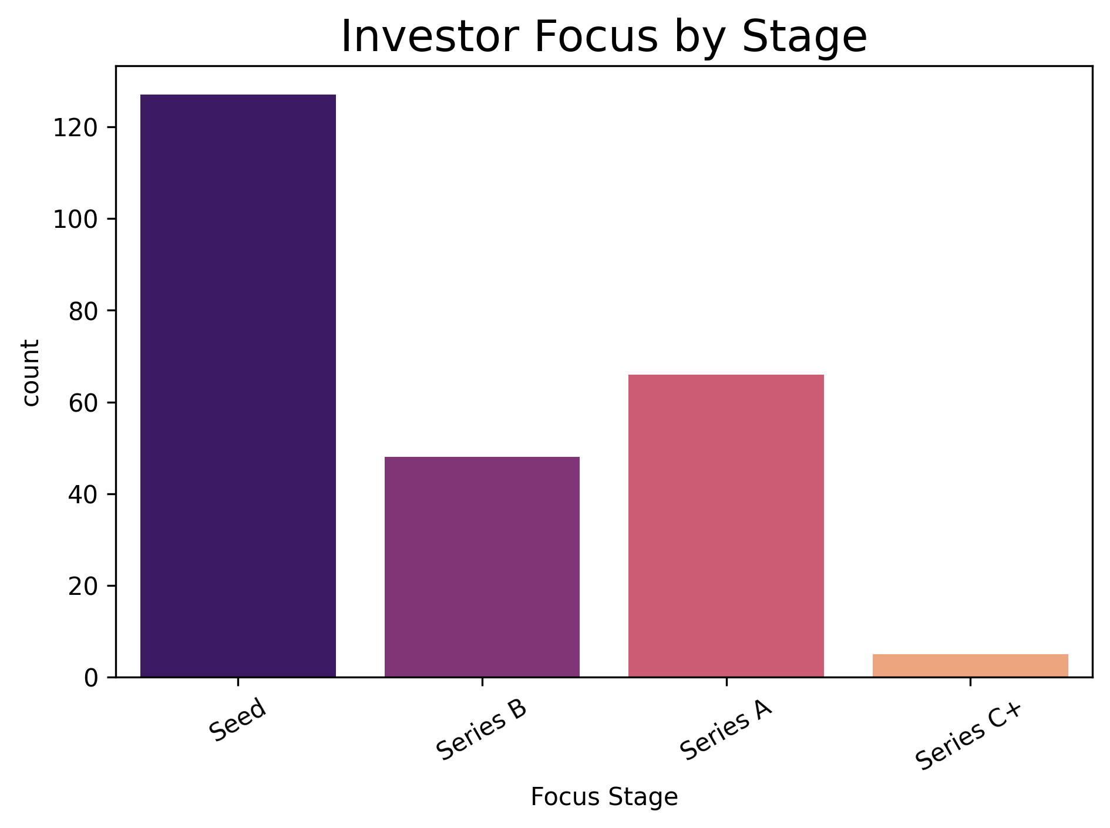
2. What funding stages do investors prefer?
Majority of Startups Are Early Stage
Bootstrapped and Seed dominate suggesting a vibrant but early-phase ecosystem
Investors focus more on Seed stage startups
Data Frank

Slide 10
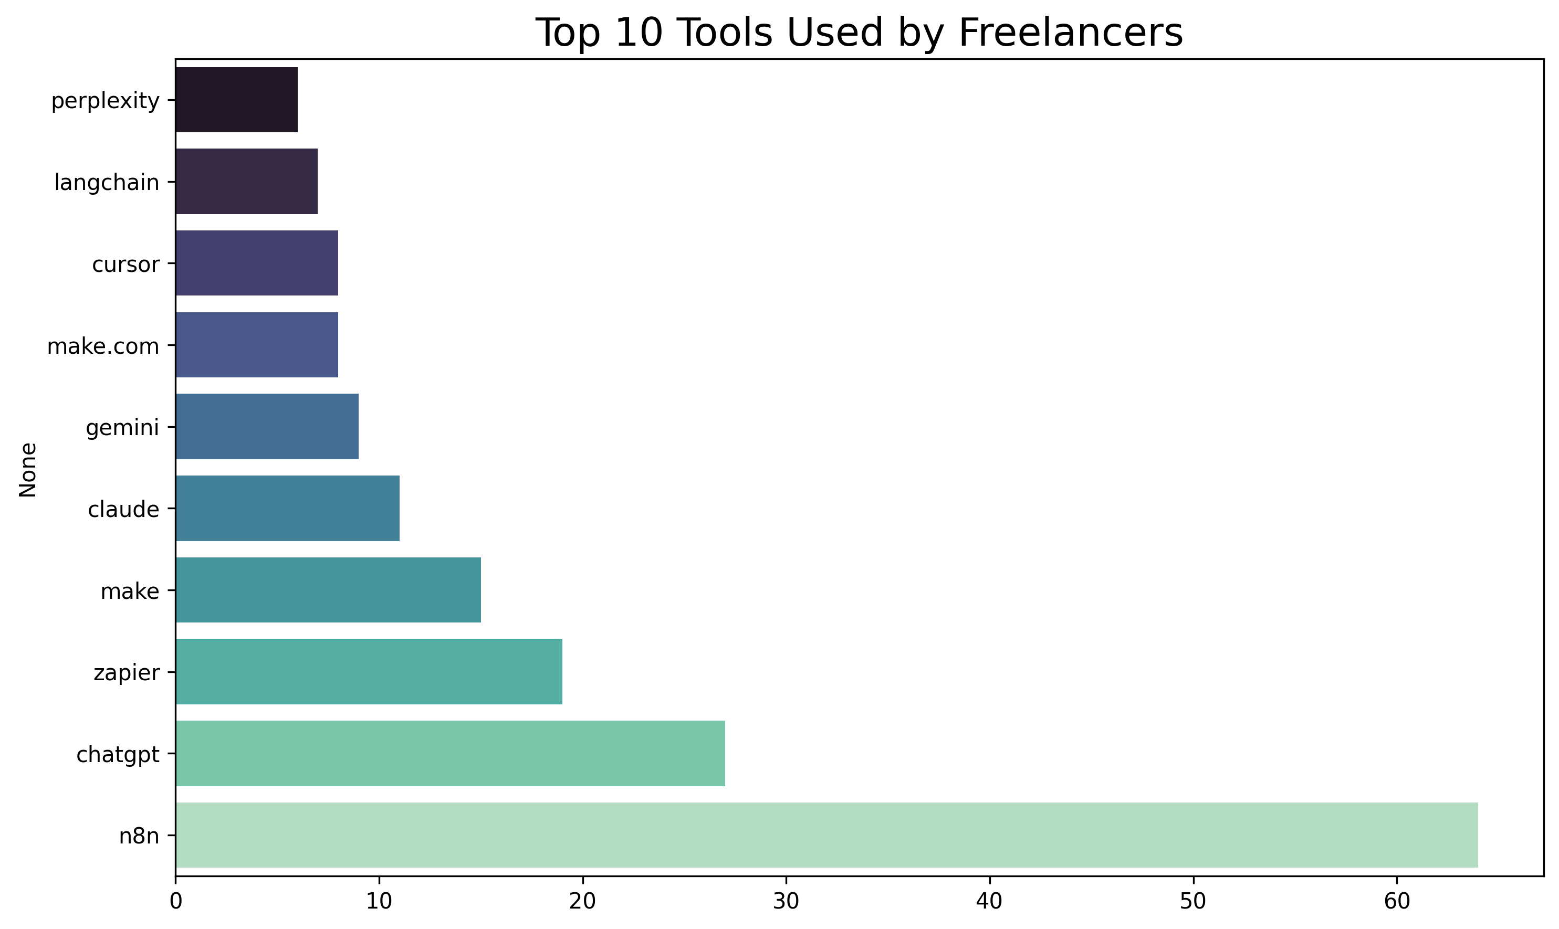
3. What tools do freelancers use most?
Majority of Freelancers are focused on automation
Top tools used: n8n, OpenAI, ChatGPT, Make
Data Frank

Slide 11
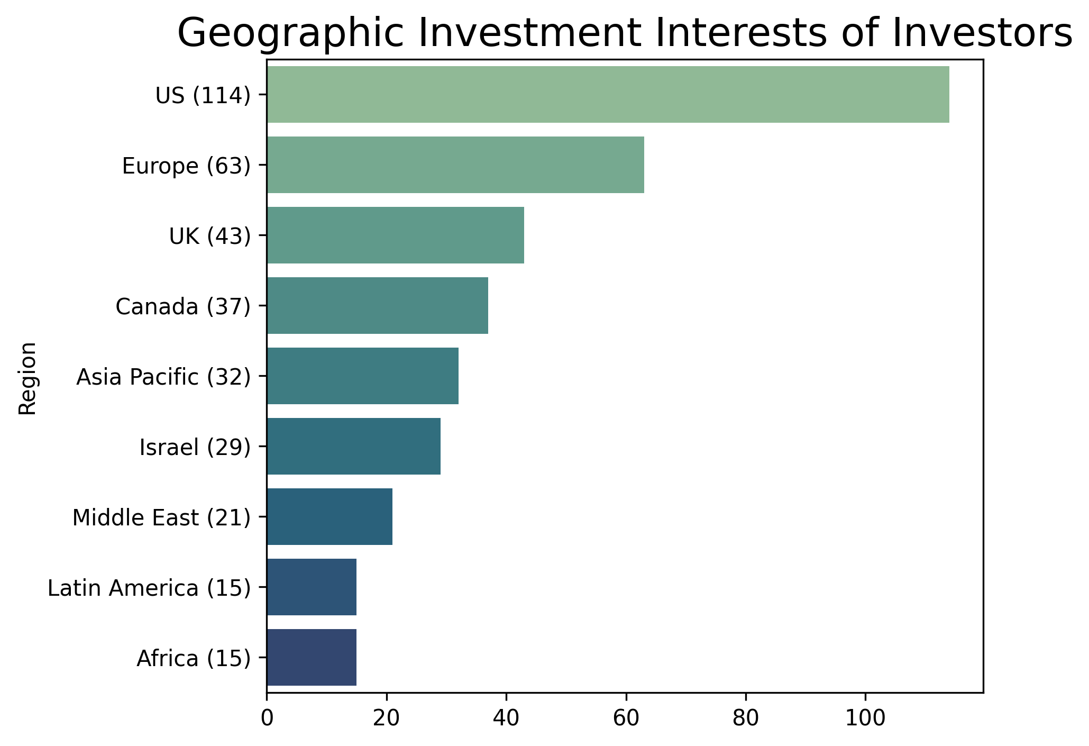
4. Where are investors focused geographically?
Majority of Investors are focused on US, Europe and UK
Canada, Asia Pacific and Israel are also of geographical interest to investors
Data Frank

Slide 12
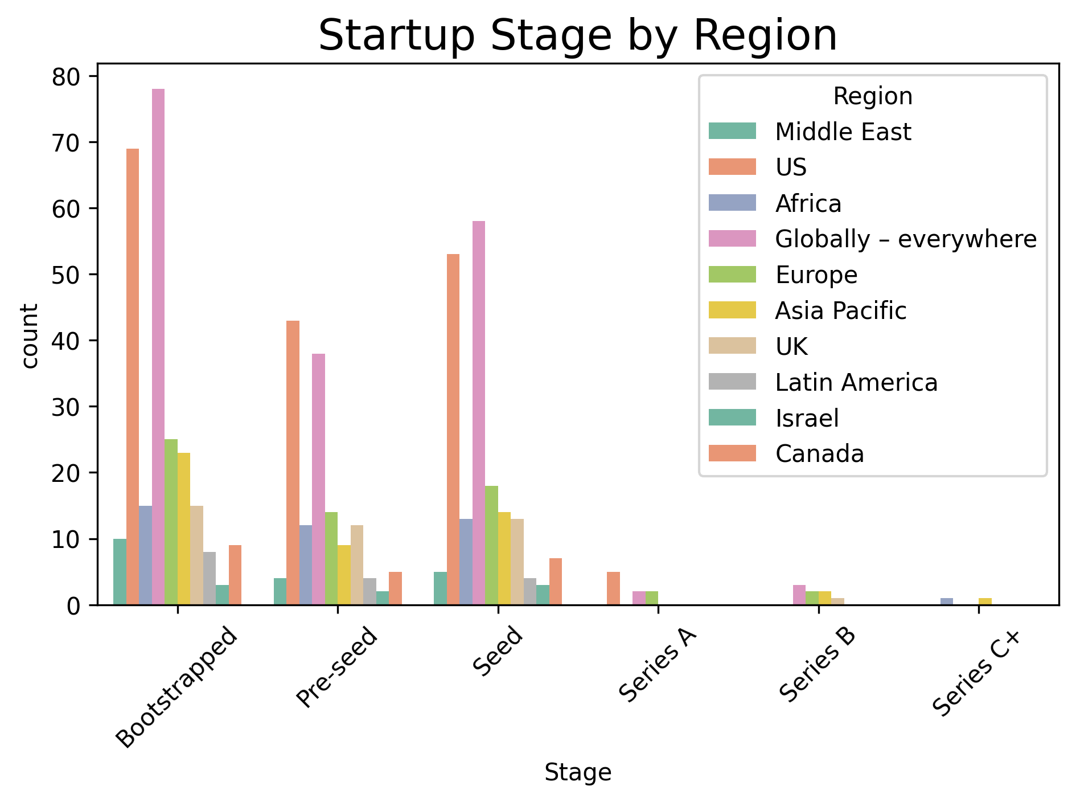
5. How do startup stages align with region?
Most Startups are in Early Stages Across All Regions as Bootstrapped, Pre-seed, and Seed stages dominate the chart across all regions.
Globally – everywhere and the US have the highest number of startups across all early stages, especially in Bootstrapped and Seed.
Data Frank

Slide 13
6. Who is seeking training or automation?
Investors (249) and Freelancers (around 115) are more inclined to learn (via courses and training) rather than implement automation.
All 2,055 founders selected all three needs — automation services, team training, and personal courses.
This suggests a very high intent to implement and understand AI both personally and organizationally.
 | Source | Wants_Automation | Wants_Team_Training | Wants_Personal_Course
0 | All Companies | 655 | 370 | 354
1 | Founders | 2055 | 2055 | 2055
2 | Freelancers | 70 | 69 | 115
3 | Investors | 249 | 249 | 249
4 | Startups | 125 | 84 | 128
Data Frank

Slide 14
Strategic Recommendations
What You Should Do With These Insights
Accelerators / Ecosystem Builders: Enable matchmaking based on stage & region alignment
Training Programs: Launch targeted training for founders and their teams with real-world AI applications
AI Service Providers: Prioritize founders interested in Process Automation and AI Services
Freelancers: Focus on toolkits involving Zapier, ChatGPT, Make, and reach out to AI-hungry founders
Investors: Expand to Africa and Asia Pacific—high founder activity, underrepresented in funding
Data Frank

Slide 15




Thank You
Okwuchukwu Onuoha
onuohafrankline99@gmail.com
Github.com/Okwy009
Data Frank

